Slide 1
Philippians 2:12-18
(English Standard Version)

Slide 2
¹² Therefore, my beloved, as you have always obeyed, so now, not only as in my presence but much more in my absence, work out your own salvation with fear and trembling, ¹³ for it is God who works in you, both to will and to work for his good pleasure.

Slide 3
¹⁴ Do all things without grumbling or disputing, ¹⁵ that you may be blameless and innocent, children of God without blemish in the midst of a crooked and twisted generation, among whom you shine as lights in the world, ¹⁶ holding fast to the word of life, so that in the day of Christ I may be proud that I did not run in vain or labour in vain. ¹⁷ Even if I am to be poured out as a drink offering upon the sacrificial offering of your faith, I am glad and rejoice with you all. ¹⁸ Likewise you also should be glad and rejoice with me.

Slide 4
Working-out our Salvation with Fear and Trembling
A practical, physical demonstration of the change that God has made in us (by saving us)
a life, that is so profoundly transformed (by God), that every physical and practical engagement we have with the world around us, has God’s fingerprints all over it.
We take this seriously. Fear & Trembling – In the constant presence of God
1. Living Righteously
A daily, ongoing outworking of the salvation we have
How to get saved – Grace not works / How to be ‘the saved’ – born again to be righteous
¹³ for it is God who works in you, both to will and to work for His good pleasure.
Romans 4:5 (ESV) ⁵ And to the one who does not work but believes in him who justifies the ungodly, his faith is counted as righteousness,
Hebrews 4:9–11 (ESV) ⁹ So then, there remains a Sabbath rest for the people of God, ¹⁰ for whoever has entered God’s rest has also rested from his works as God did from his. ¹¹ Let us therefore strive to enter that rest…..

Slide 5
Working-out our Salvation with Fear and Trembling
A practical, physical demonstration of the change that God has made in us (by saving us)
a life, that is so profoundly transformed (by God), that every physical and practical engagement we have with the world around us, has God’s fingerprints all over it.
We take this seriously. Fear & Trembling – In the constant presence of God
1. Living Righteously
A daily, ongoing outworking of the salvation we have
How to get saved – Grace not works / How to be ‘the saved’ – born again to be righteous
¹³ for it is God who works in you, both to will and to work for His good pleasure.
God works in us so that we will want to do His Good Pleasure & empowers us to do it.
Blameless; innocent; unblemished; Light; in contrast to a crooked & twisted generation
2. Being Unified in Christ
¹⁴ Do all things without grumbling or disputing,
3. Being a light in the World
Disciples of Jesus, are distinct from the world (we have different values)

Slide 6
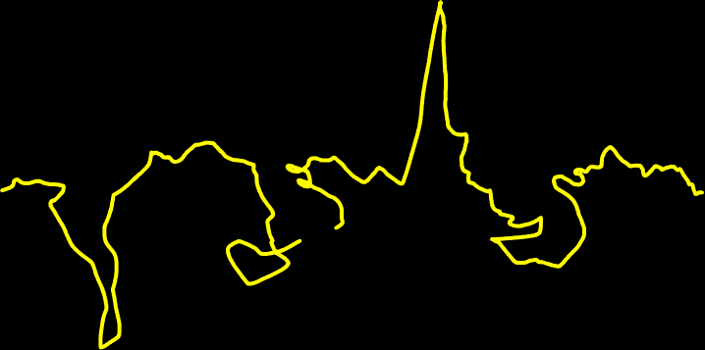

God’s Values
Never changing
Straight
Pure
Holy
The World’s Values
ever changing
crooked
twisted

Slide 7
Working-out our Salvation with Fear and Trembling
A practical, physical demonstration of the change that God has made in us (by saving us)
a life, that is so profoundly transformed (by God), that every physical and practical engagement we have with the world around us, has God’s fingerprints all over it.
We take this seriously. Fear & Trembling – In the constant presence of God
1. Living Righteously
A daily, ongoing outworking of the salvation we have
How to get saved – Grace not works / How to be ‘the saved’ – born again to be righteous
God works in us so that we will want to do His Good Pleasure & empowers us to do it.
Blameless; innocent; unblemished; Light; in contrast to a crooked & twisted generation
2. Being Unified in Christ
¹⁴ Do all things without grumbling or disputing,
3. Being a light in the World
Disciples of Jesus, are distinct from the world (we have different values)
4. Continuing in the faith
be blameless and innocent, children of God without blemish in the midst of a crooked and twisted generation, among whom you shine as lights in the world, ¹⁶ holding fast to the word of life....

Slide 8
Working-out our Salvation with Fear and Trembling
A practical, physical demonstration of the change that God has made in us (by saving us)
a life, that is so profoundly transformed (by God), that every physical and practical engagement we have with the world around us, has God’s fingerprints all over it.
We take this seriously. Fear & Trembling – In the constant presence of God
1. Living Righteously
A daily, ongoing outworking of the salvation we have
How to get saved – Grace not works / How to be ‘the saved’ – born again to be righteous
God works in us so that we will want to do His Good Pleasure & empowers us to do it.
Blameless; innocent; unblemished; Light; in contrast to a crooked & twisted generation
2. Being Unified in Christ
¹⁴ Do all things without grumbling or disputing,
3. Being a light in the World
Disciples of Jesus, are distinct from the world (we have different values)
4. Continuing in the faith
¹⁶ holding fast to the word of life, so that in the day of Christ I may be proud that I did not run in vain or labour in vain.
Hold fast to the Gospel in which we believe

Slide 9
Working-out our Salvation with Fear and Trembling
A practical, physical demonstration of the change that God has made in us (by saving us)
a life, that is so profoundly transformed (by God), that every physical and practical engagement we have with the world around us, has God’s fingerprints all over it.
We take this seriously. Fear & Trembling – In the constant presence of God
1. Living Righteously
A daily, ongoing outworking of the salvation we have
How to get saved – Grace not works / How to be ‘the saved’ – born again to be righteous
God works in us so that we will want to do His Good Pleasure & empowers us to do it.
Blameless; innocent; unblemished; Light; in contrast to a crooked & twisted generation
2. Being Unified in Christ
¹⁴ Do all things without grumbling or disputing,
3. Being a light in the World
Disciples of Jesus, are distinct from the world (we have different values)
4. Continuing in the faith
¹⁷ Even if I am to be poured out as a drink offering upon the sacrificial offering of your faith, I am glad and rejoice with you all. ¹⁸ Likewise you also should be glad and rejoice with me.
Hold fast to the Gospel in which we believe
Paul’s marvellous example of willing and working for God’s good pleasure. It cost Him His freedom & Life, but what joy when Christ is everything

